Slide 1
All Contigs Scatterplot
Y = Mashpee
X = Barnstable

Slide 2
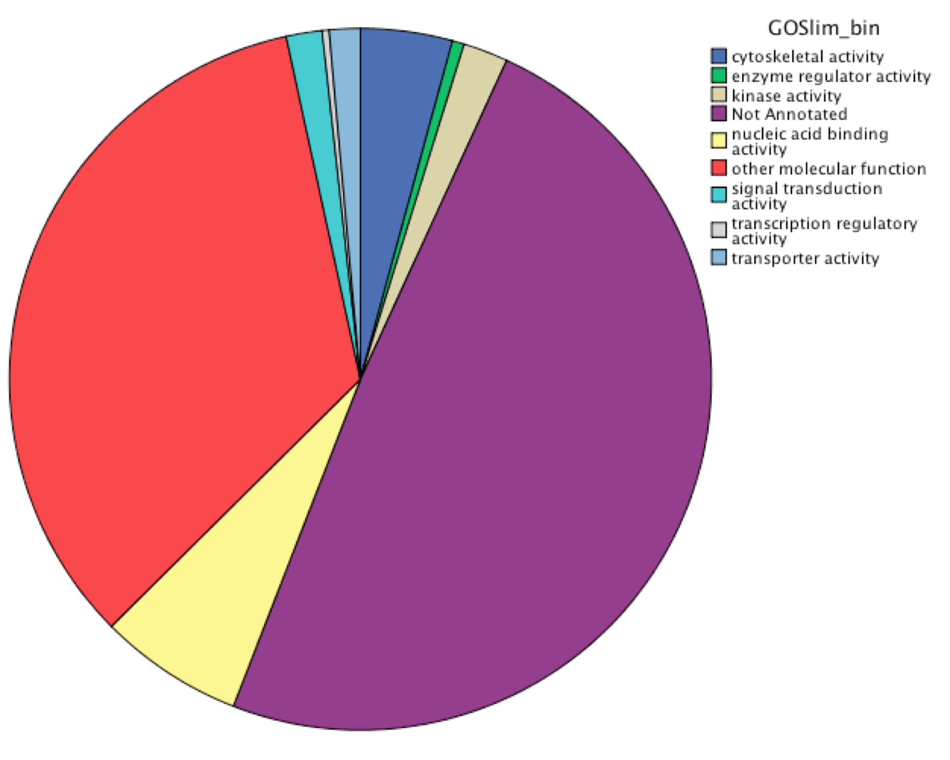
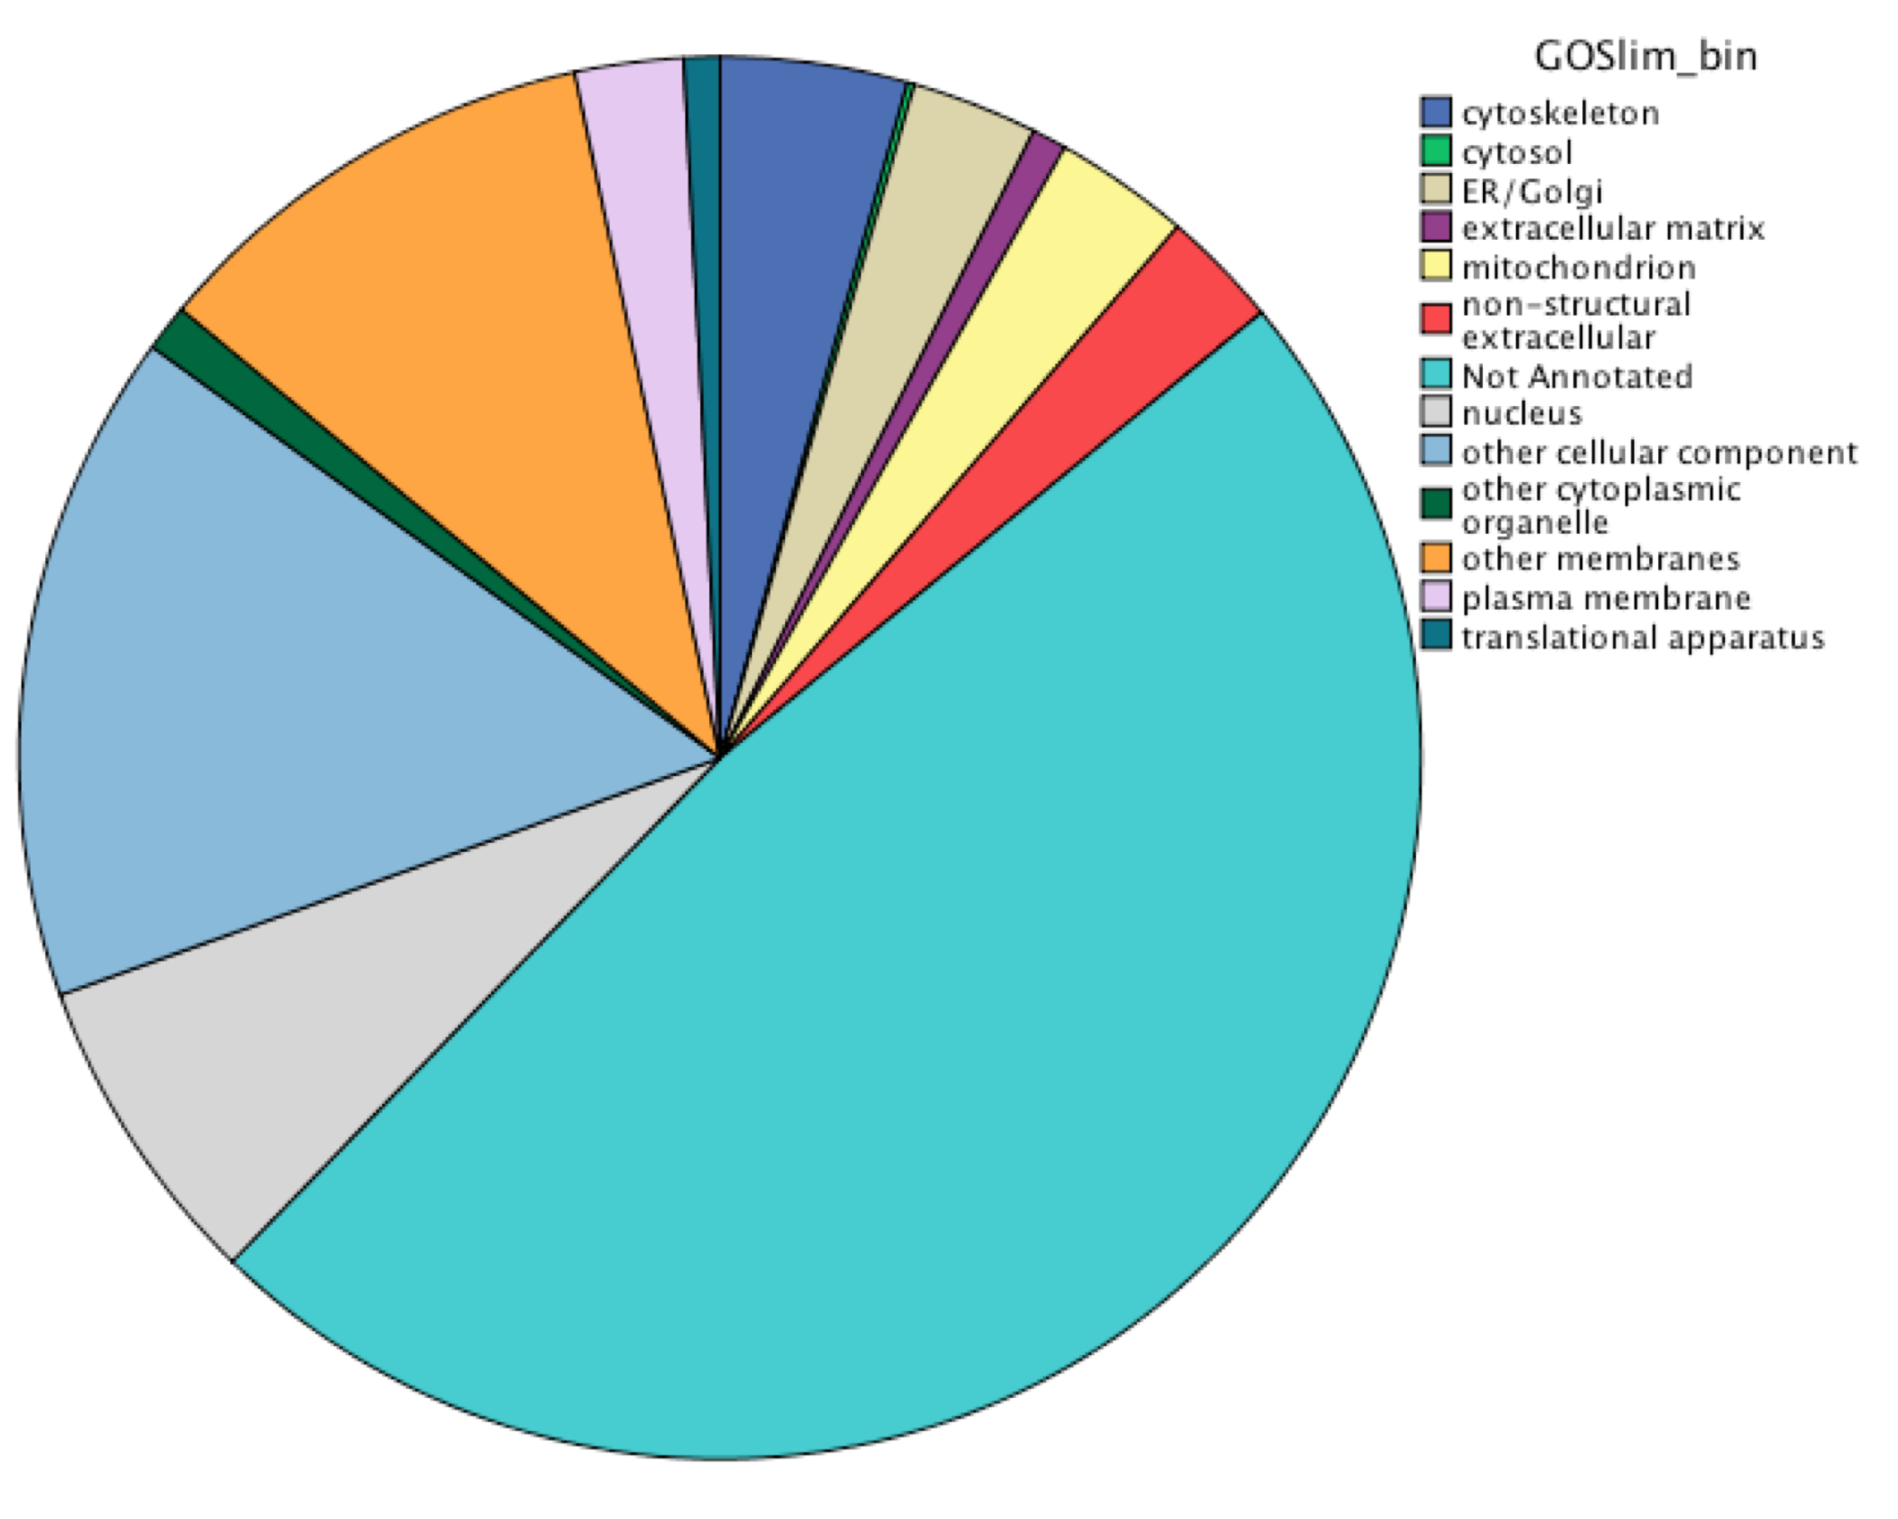
Molecular Function
Biological Process
Cellular Component

Slide 3
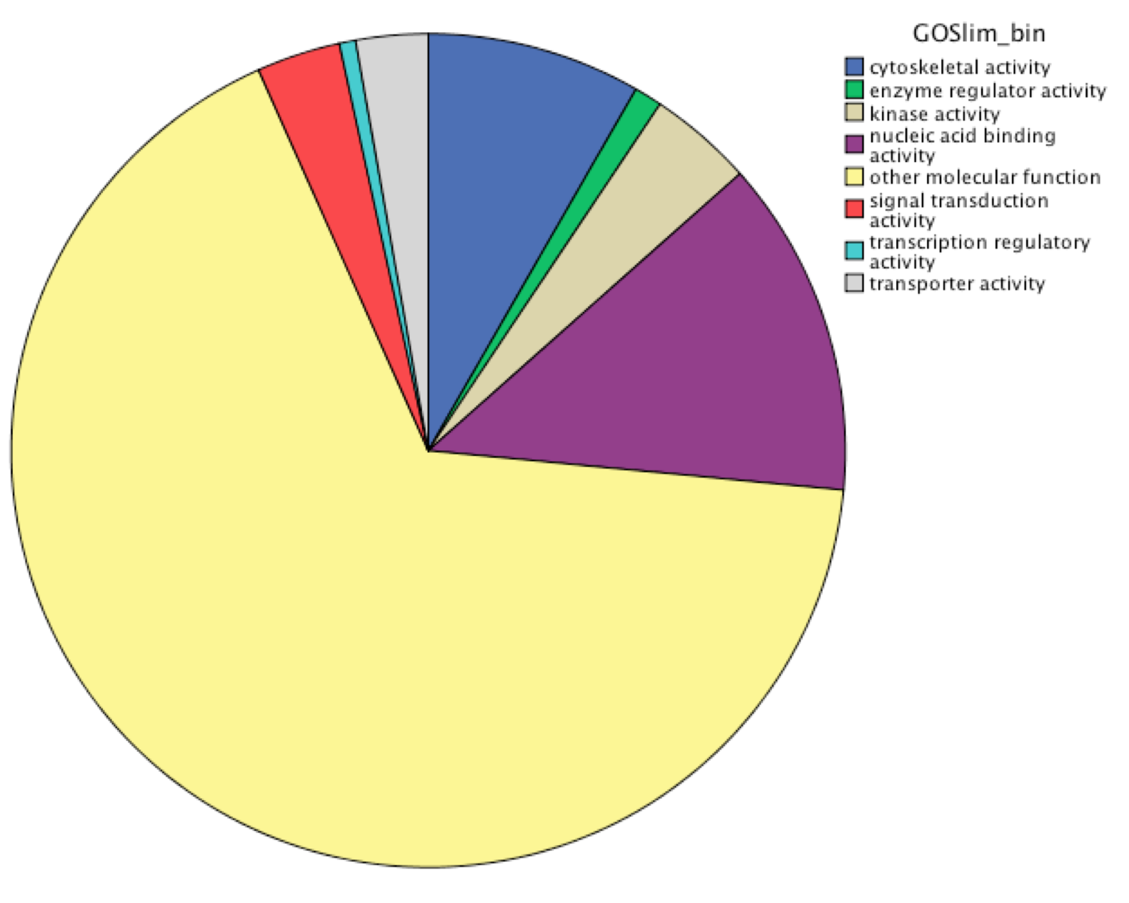
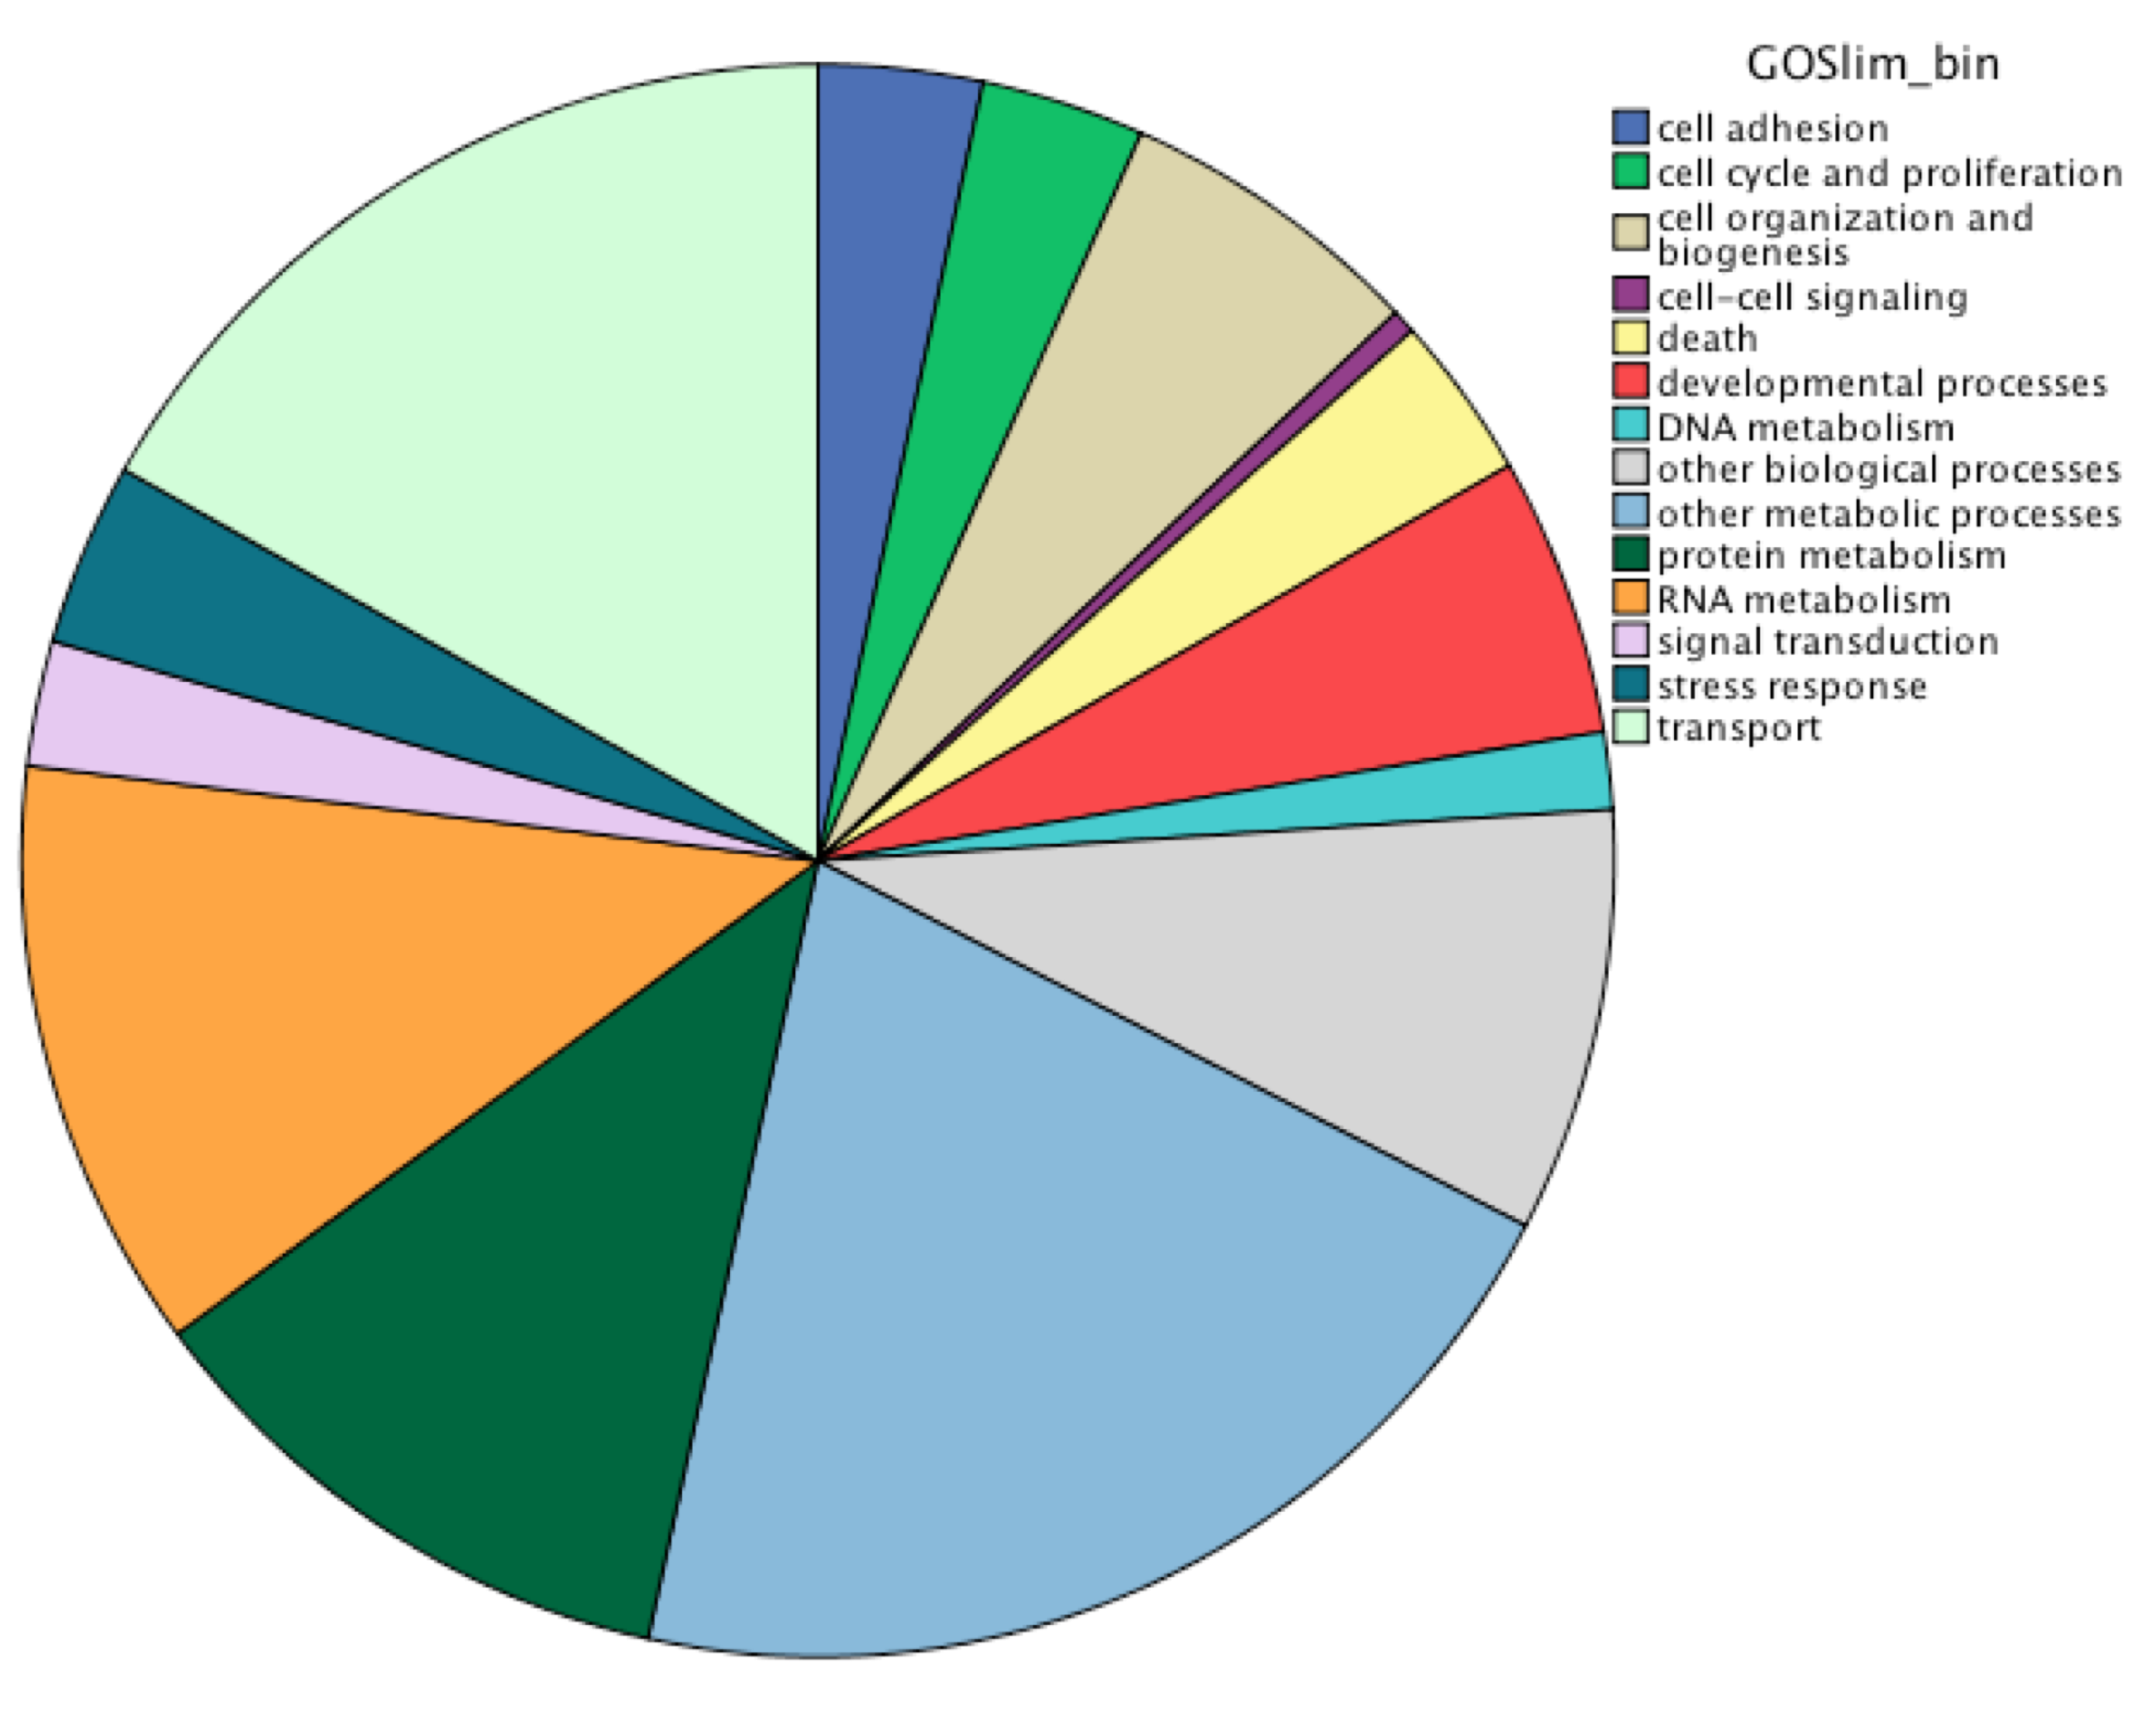
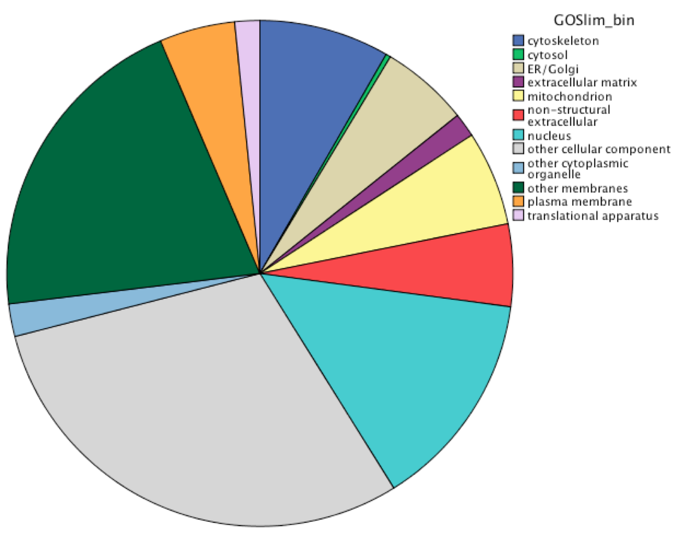
Molecular Function
Biological Process
Cellular Component

Slide 4
Significant but < 2 Fold
2 Fold< x < 4 Fold
Molecular Function
4 Fold Barnstable
4 Fold Mashpee

Slide 5
Significant but < 2 Fold
2 Fold< x < 4 Fold
Molecular Function Continued…
4 Fold Barnstable
4 Fold Mashpee

Slide 6
Significant but < 2 Fold
2 Fold< x < 4 Fold
Biological Process
4 Fold Barnstable
4 Fold Mashpee

Slide 7
Significant but < 2 Fold
2 Fold< x < 4 Fold
Biological Process Continued
4 Fold Barnstable
4 Fold Mashpee

Slide 8
Significant but < 2 Fold
2 Fold< x < 4 Fold
Biological Process Continued…
4 Fold Barnstable
4 Fold Mashpee

Slide 9
Significant but < 2 Fold
2 Fold< x < 4 Fold
Biological Process Continued
4 Fold Barnstable
4 Fold Mashpee

Slide 10
Significant but < 2 Fold
2 Fold< x < 4 Fold
4 Fold Barnstable
Cellular Component
4 Fold Mashpee

Slide 11
Significant but < 2 Fold
2 Fold< x < 4 Fold
4 Fold Barnstable
Cellular Component Continued…
4 Fold Mashpee

Slide 12
Significant but < 2 Fold
2 Fold< x < 4 Fold
4 Fold Barnstable
Cellular Component Continued…
4 Fold Mashpee

Slide 13
Molecular Function
Biological Process
Cellular Component
GO Slim
All Significant
All Annotated
> 2 Fold change

Slide 14
Molecular Process

Slide 16
Cellular Component

Slide 17
Cellular Function
2+ Fold Changes by GO Slim
Barnstable
Mashpee

Slide 18
Barnstable 2+ Fold Change GO Names

Slide 19
Mashpee 2+ Fold Change GO Names

Slide 20
Cellular Process
2+ Fold Change by GO Slim
Barnstable
Mashpee

Slide 21
Barnstable 2+ Fold Change Cellular Process GO Names

Slide 22
Mashpee 2+ Fold Change Cellular Process GO Names

Slide 23
Cellular Component
2+ Fold Change by GO Slim

Slide 24
Barnstable 2+ Fold Change Cellular Component GO Names

Slide 25
Mashpee 2+ Fold Change Cellular Component GO Names

